Slide 1

HDF Group Support for NPP/JPSS
Mike Folk, Elena Pourmal, Larry Knox, Albert Cheng
The HDF Group
The 15th HDF and HDF-EOS Workshop
April 17-19, 2012

Slide 2
Goal
Provide HDF5 support for the distribution of VIIRS, OMPS, and other JPSS sensor and environmental data products

Slide 3
2011-2012 Priorities
Test software on platforms critical to NPP/JPSS
Develop software to facilitate access and management of NPP/JPSS products
Provide rapid and high priority support for data producers and users

Slide 4
Project Information
Project Web site
  http://www.hdfgroup.org/projects/npoess/
Project Wiki
  http://confluence.hdfgroup.uiuc.edu/display/indproj/NPOESS+Project

Slide 5
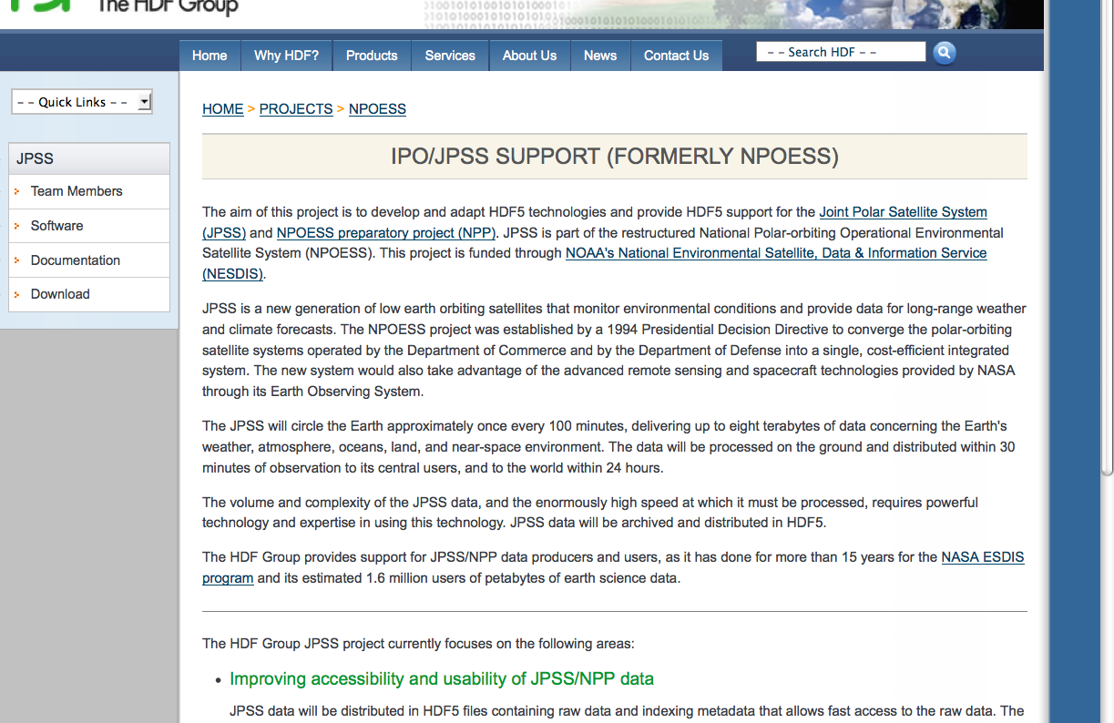
JPSS Released Software
Notes:
The page has links to the JPSS software description, downloads, and documentation

Slide 6
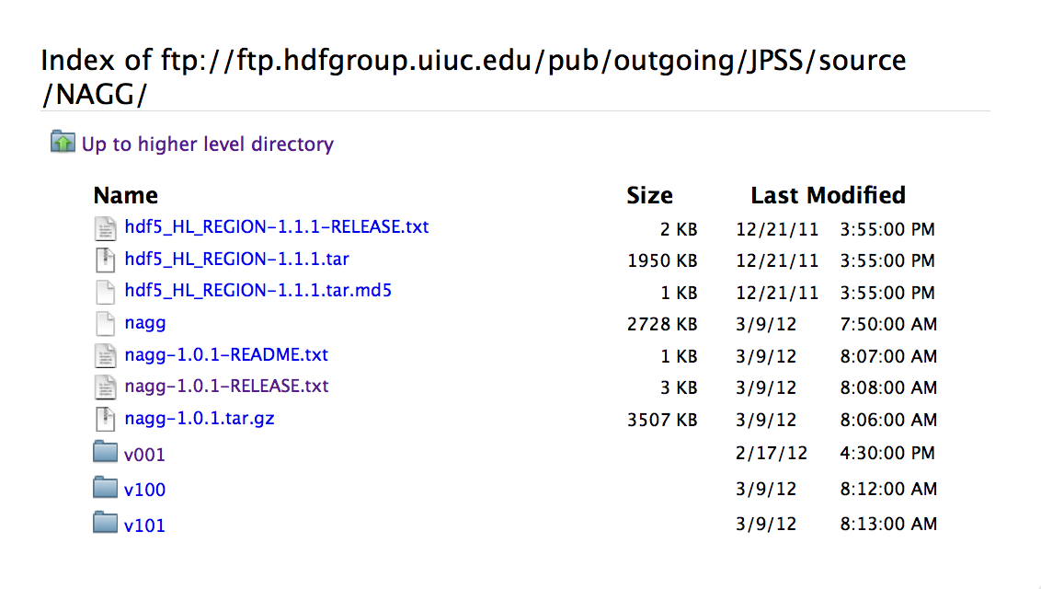
Software under Development

Slide 7
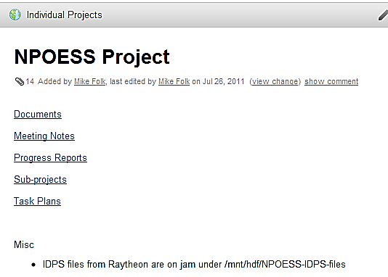
HDF NPOESS Wiki

Slide 8
JPSS Software

Slide 9
h5edit
h5edit is a command line tool that can also be used to edit attributes.
Example: add scale_factor attribute
  h5edit -c "CREATE /Radiance scale_factor {H5T_IEEE_F32LE SIMPLE(1) DATA{2.8339462E-4}};" file.h5
Example: add units attribute:
  h5edit -c "CREATE /Longitude units {H5T_STRING { STRSIZE 12 } DATA {'degrees_east'}};” file.h5

Slide 10

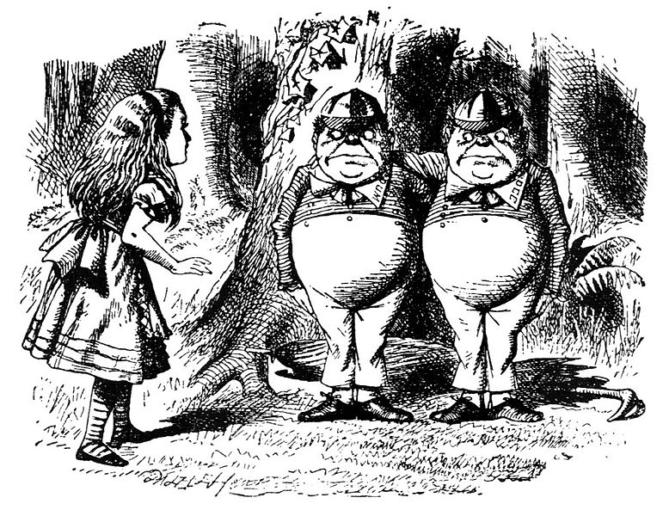


h5augjpss
netCDF-4
“Augmentation”
Making an HDF5 JPSS file look like a netCDF-4 file
HDF5

Slide 11
Clarification
netCDF-3 files
  Based on netCDF classic data model
netCDF-4 files
  Based on netCDF enhanced model
  Uses HDF5 as a storage layer
  Group hierarchy, user-defined data types, etc.
  But can be restricted netCDF classic
NPP files
  HDF5 file with primary data
    Incompatible with netCDF, unless modified
  XML metadata file
    Important information, including dimensions
  Geo data in separate file, or group in primary file

Slide 12
h5augjpss
h5augjpss will add metadata or data to the JPSS HDF5 file for certain options and
hide HDF5 elements not supported by netCDF applications for other options.

Slide 13
Augmenting JPSS files
File.h5
h5augjpss
Step 1: Hide HDF5 objects unknown to netCDF-4
File.h5
netCDF-4 readable
File.XML
Step 2: Update with info from File.XML
File.h5
GEO.h5
netCDF-4 meaningful
Step 3: Update w info from GEO.h5
netCDF-4 geolocation conformant
File.h5
Notes:
Step 1:
There are objects in the JPSS file that confuse netCDF-4, so these need to be hidden.
Step 2:
Dimension information can be important in order to have an understanding of the data, and it is an important component of the netCDF data model. Fortunately, this dimension information is in fact available, though not in the product file. JPSS stores this information in a separate metadata file called the JPSS “XML product file.”
Step 3:
Applications such as IDV and Panoply that provide visualization of datasets (variables) in the context of a geographic map will not display the data without the geolocation information. The augmentation tool can be used to add the geolocation information to the JPSS product file. This information is found in another JPSS file, which we’re calling here geo.h5.

Slide 14

But wait…there’s more!

Slide 15
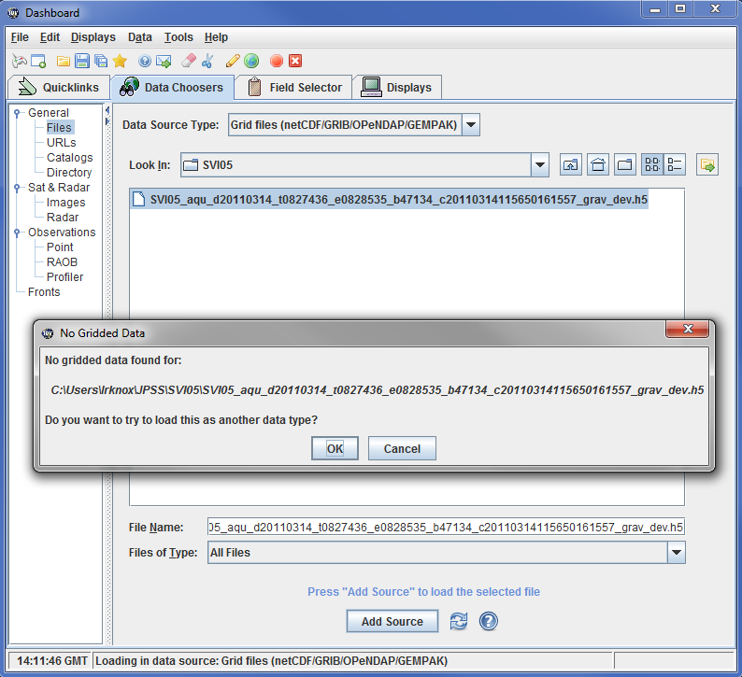
IDV before augmentation

Slide 16
Two problems
Has to be netCDF-3 conformant
  h5augjpss –o4 SVI05.h5
Missing CF metadata
  h5edit -c "CREATE /Radiance scale_factor {H5T_IEEE_F32LE SIMPLE(1) DATA{2.8339462E-4}};" SV105.h5
  h5edit -c "CREATE /Longitude units {H5T_STRING { STRSIZE 12 } DATA {'degrees_east'}};” SV105.h5

Slide 17
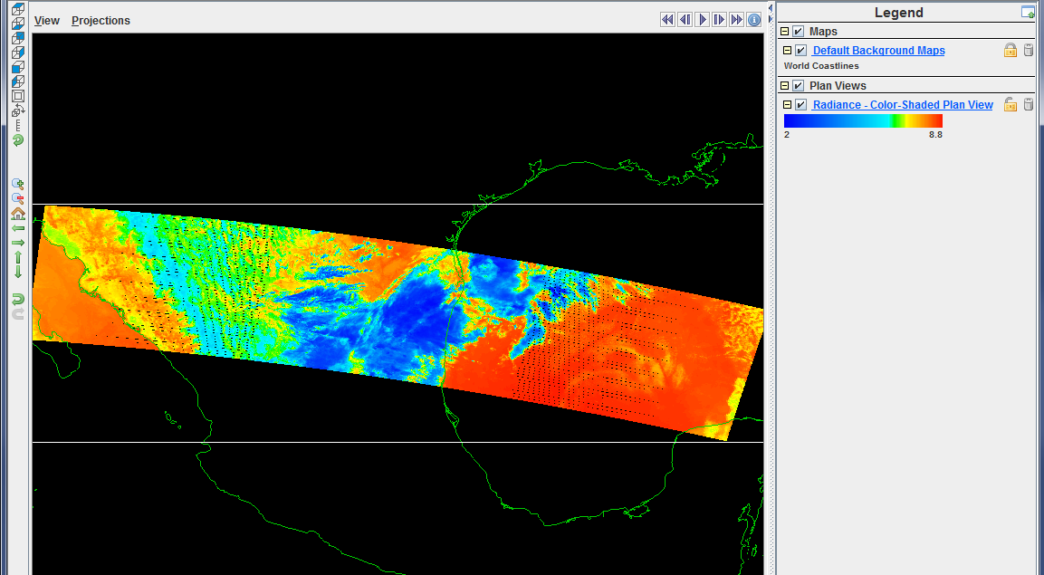
IDV after augmentation
IDV with augmented JPSS file

Slide 18
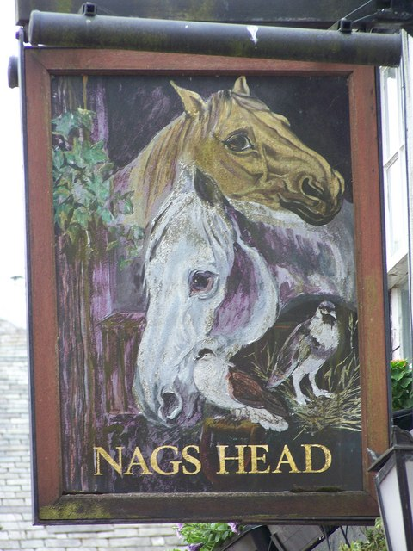
nagg
NPP
aggregation
tool
Notes:
Photo: Sign for the Nags Head Pub, Brampton. Photo by Trish Steel

Slide 19
Why nagg?
NPP data products organized as “granules.”
Granules are relatively small.
Several granules may be packaged per file.
Several products may be packaged per file.
For convenience of a particular application, we may want to re-package them.
May also want only a subset of them.
(Thanks to Richard Ullman)
Notes:
Data products are organized as “granules.”
Granules are made relatively small for convenience of handling them.
Several granules may be packaged per file, and usually are.
E.g. 16 granules per file.
For convenience of a particular application, we may want to package them differently.
E.g. 1,000 granules per file instead of 16.
We may also want just a subset of all available granules.
E.g. those measurements taken during a particular time period.
That is what nagg does.
"For NPP, the concept of a granule is independent of the packaging of the granule in a file, so we make granules relatively small in order to conveniently manipulate them, but we can package them into arbitrary numbers of granules for the convenience of the particular application. "
nagg is needed to address the flexibility of NPP products, especially swaths products. A swath is a ribbon of data collected as the satellite orbit sweeps across the Earth. As an orbit is continuous, the swath is continuous, wrapping around the Earth over and over again like a yarn on a ball. In most NASA heritage missions, the ribbon of swath is snipped into equal size pieces which we call granules, and one granule is placed in each file. The size of the snipped piece while usually set for each mission, varies from mission to mission based mostly on the amount of data and therefore the size of the file that can be conveniently manipulated.
For NPP, the concept of a granule is independent of the packaging of the granule in a file, so we make granules relatively small in order to conveniently manipulate them, but we can package them into arbitrary size for the convenience of the particular application. For example, when comparing a MODIS 5 minute data granules to the VIIRS data, if is useful to package four VIIRS 86 second granules together to make the piece of swath similar in size to the MODIS granule. Some data analysis tools analyze by full orbit, so it is convenient to package OMPS data that way. Nagg makes it possible for the analyst to package NPP data into files in the way that best suits them. -Rich (You could think of the NPP relationship of a granule to a product swath to be similar to the HDF relationship between a chunk and a dataset.)

Slide 20
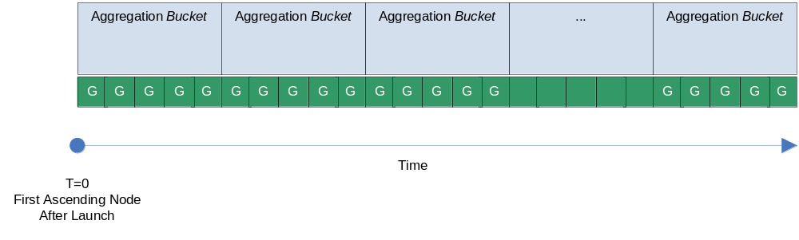
Aggregation Buckets

Slide 21
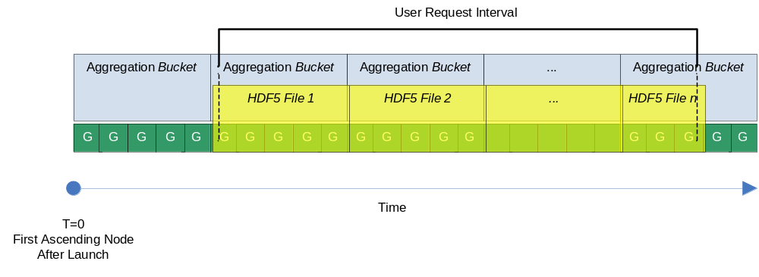
Aggregation Example
User request co-aligns with the aggregation bucket start
HDF5 files are ‘full’ aggregations (full, relative to the aggregation period)
Notes:
Because requests might not start on bucket boundaries, there are various special cases to consider. Here’s one case.

Slide 22
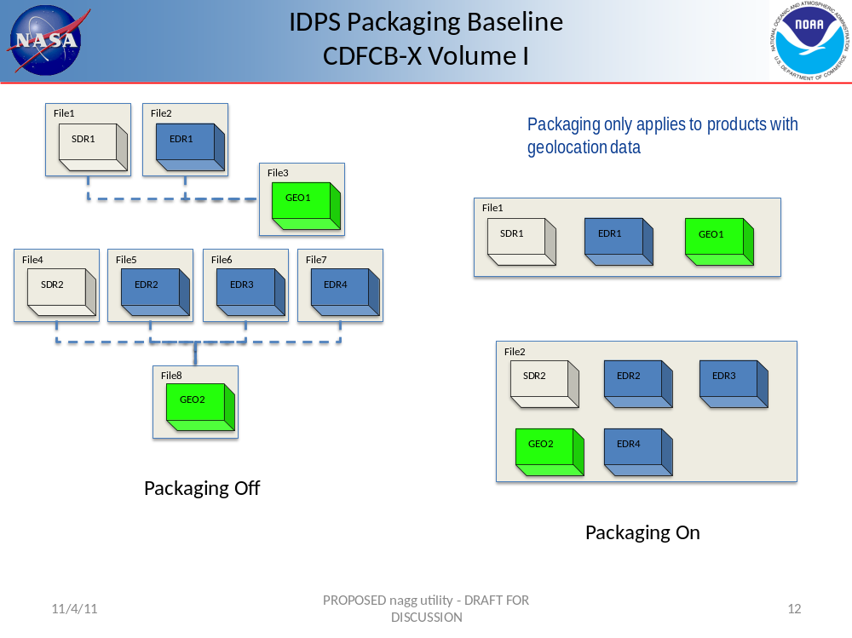
Always makes a new copy. Doesn’t destroy the original file.
Notes:
Another issue is packaging.
Recall (from the h5augjpss material) that there is a geo file associated with the data files.
The information in the geo file may be put in the same HDF5 file with the actual data record, or packaged separately.
Here’s an example of that.
Issues of whether to package and how much have to be accommodated by the tool.

Slide 23
Thank You!

Slide 24
Acknowledgements
This work was supported by Subcontract number HDF-1000 under Raytheon Contract number DG133E07CQ0055, and by Subcontract number 114820 under Raytheon Contract number NNG10HP02C, both funded by the National Aeronautics and Space Administration (NASA).
Any opinions, findings, conclusions, or recommendations expressed in this material are those of the authors and do not necessarily reflect the views of Raytheon or NASA.

Slide 25
Questions/comments?

Slide 26
Options that add data or metadata:
  -o2 Adds metadata from JPSS XML product file
  -o3 Adds geo-location datasets from file in
Options that hide HDF5 elements unknown to netCDF-4 or netCDF-applications:
  -o1 Hides group containing reference types
  -o4 Adds links to datasets in /All_Data/… group and hides group structure

Slide 27
Options to undo hiding of HDF5 elements:
  -r1 Reverses hiding of /Data_Products group
  -r4 Reverses hiding of /All_Data group structure and removes the added links

